Slide 1
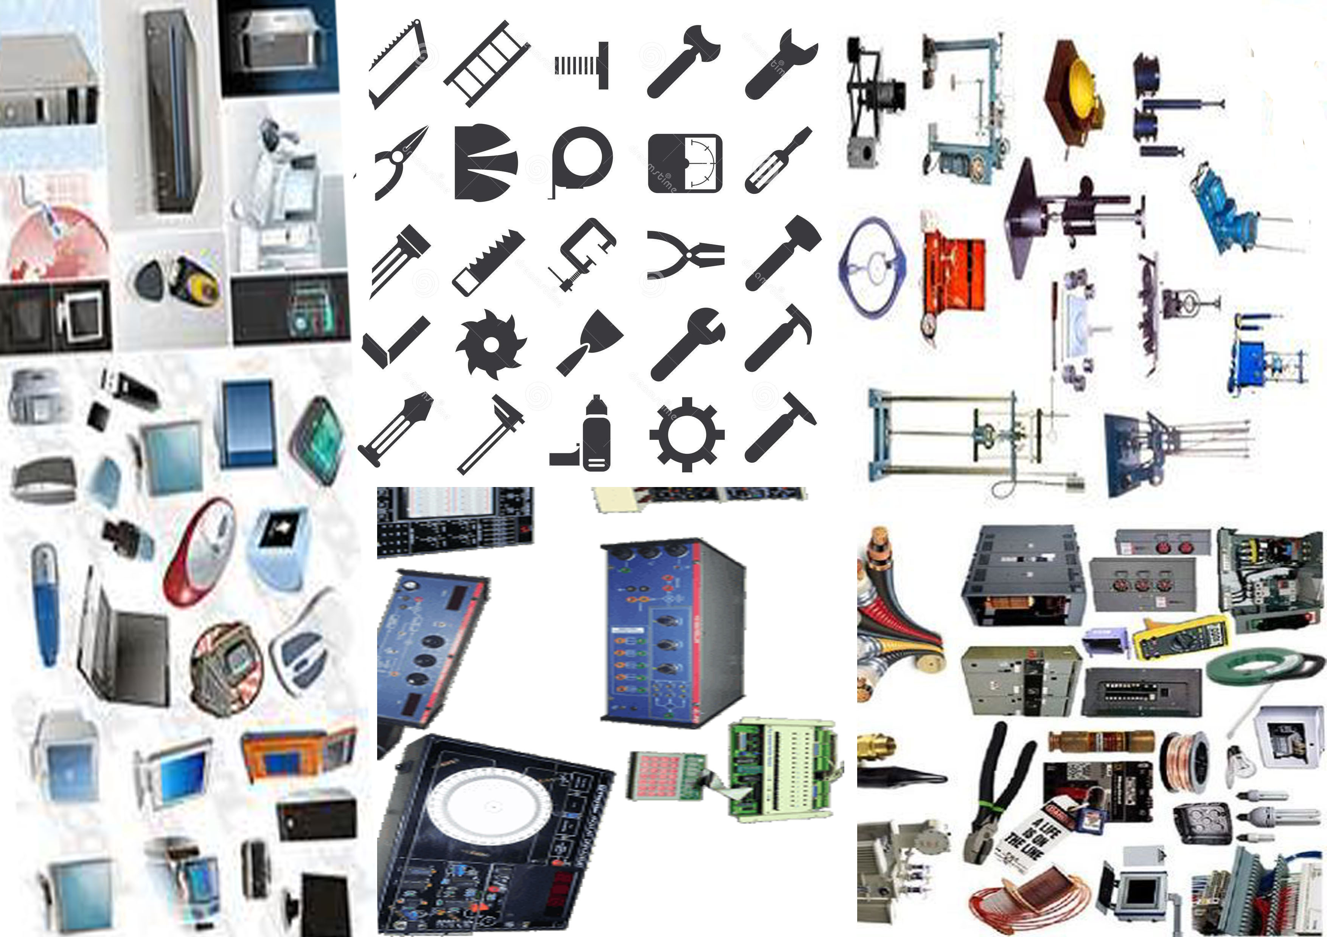
EQUIPMENT
MANAGEMENT
SYSTEM

Slide 2
UNDER THE GUIDANCE OF:
Mr.KHAIRE R.B
Presented By:
1. Shaikh Jasmine Kauser[33143]
2. Shaikh Afshan Tabassum[33158]
3. Priyanka Wagh[33154]
4. Rupali Jadhav[33175]

Slide 3
We have to see this content
OBJECTIVE
INTRODUCTION
LITERATURE SURVEY
EXISTING AND PROPOSED SYSTEM
MODULES AND SYSTEM ARCHITECTURE
6. SCREEN SHOTS
DISADVANTAGES
APPLICATIONS
CONCLUSION
REFERENCE.

Slide 4
OBJECTIVE
Firstly you don’t know about project in detail.
Project is web based application i.e Equipment management system.
As you know this project is for our college for maintaining the equipments.
This project is made by the coding of PHP i.e. Personal Home Page.
5. In this project we have to collect record of every branch/Department Equipment
6. It will show reminder for caliberation.
7. And in each department there is different labs.

Slide 5
INTRODUCTION
In Equipment Management system we are managing equipment which are Available in different labs of different branches .
It will show all equipment are properly working or not . This software will help to know total number of equipment's present in the college regarding different labs.
The system provides graphical representation of the entire college. The purpose of the system is to collect variable equipment data to facilitate equipment utilization improvement.

Slide 6
LITERATURE SURVEY
It is used in industries, hospitals , colleges,
Like for example In company it is used.

Slide 7
EXISTING AND PROPOSED SYSTEM
Existing System.
Because, data stored on the pc will have to be sent manually everytime to any authority when he needs it.
The data will be lost if the pc crashes.
When stored on the server the data is more secure.

Slide 8
Proposed System
It will improve the present scenario because our application is web based and existing system was not has access to web.
It reduces the manual work or paper work.

Slide 9
Module of our application
Addition of the equipments. Its fields
Transferring the equipments
Verification report generation
D18 generation
Staff management by the respective HOD.

Slide 10
System Architecture
Server client concept
Data sharing. With all the data stored in a central server accessible to all the computer with password, within the building
Data edited will reflect to all those with view permission for that data.
PHP was used on the server side.
Mysql database management system was used to store the data.
An apache server simulator was used, along with mysql database simulator.

Slide 11
By using this software we made a software through PHP
coding
X - CROSS PLATFORM (Means you can install XAMPP on any OS
A - APACHE SERVER( To run PHP Script on local Machine you need a Server)
M - MYSQL (To store data in database and to perform database operation you need MYSQL)
P - PHP( Well known Scripting language to create dynamic website)
P- Perl Programming Language.

Slide 12
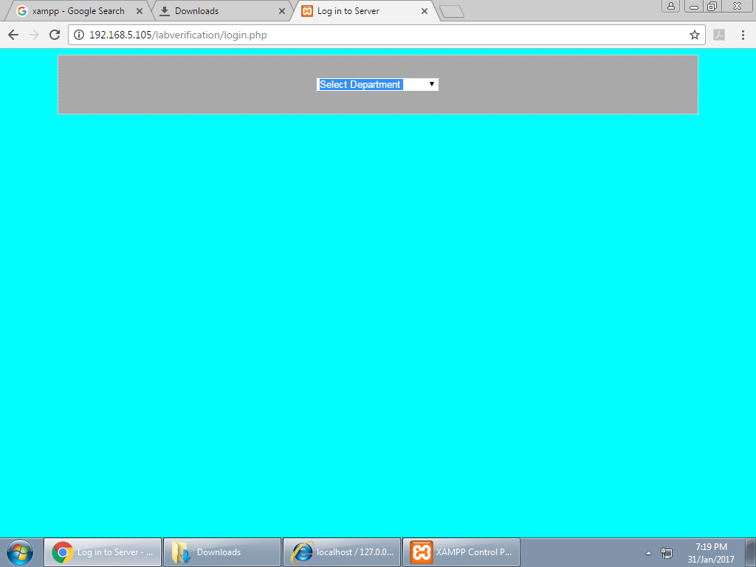
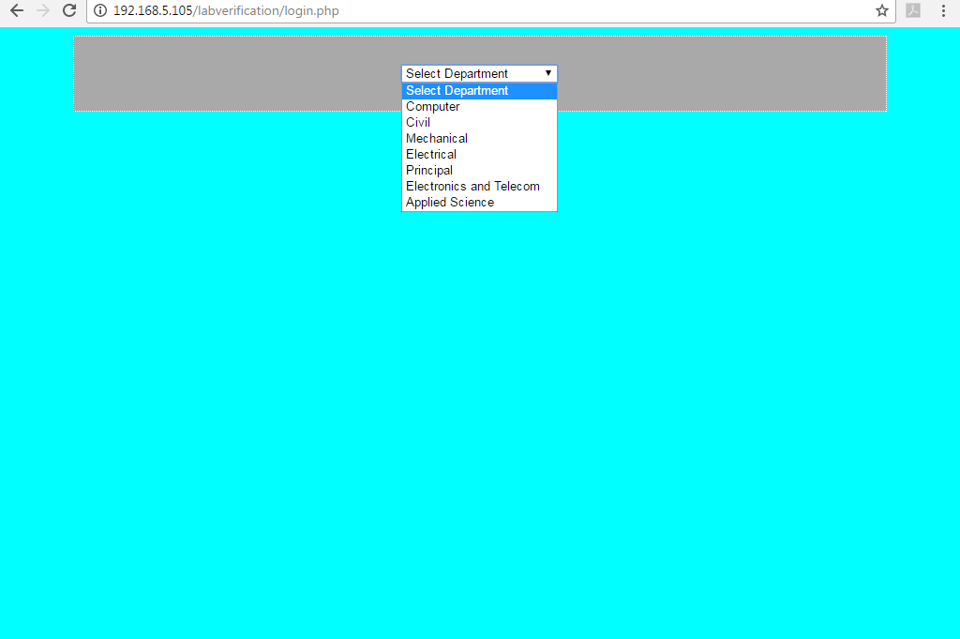
LOGIN DEPARTMENT HERE IS THE LIST OF DEPARTMENT
This is the Login Department from which we can choose different departments.
Here is the list of different Departments like Computer, Electrical, Mechanical, Civil , Electronic ,Applied Science

Slide 13
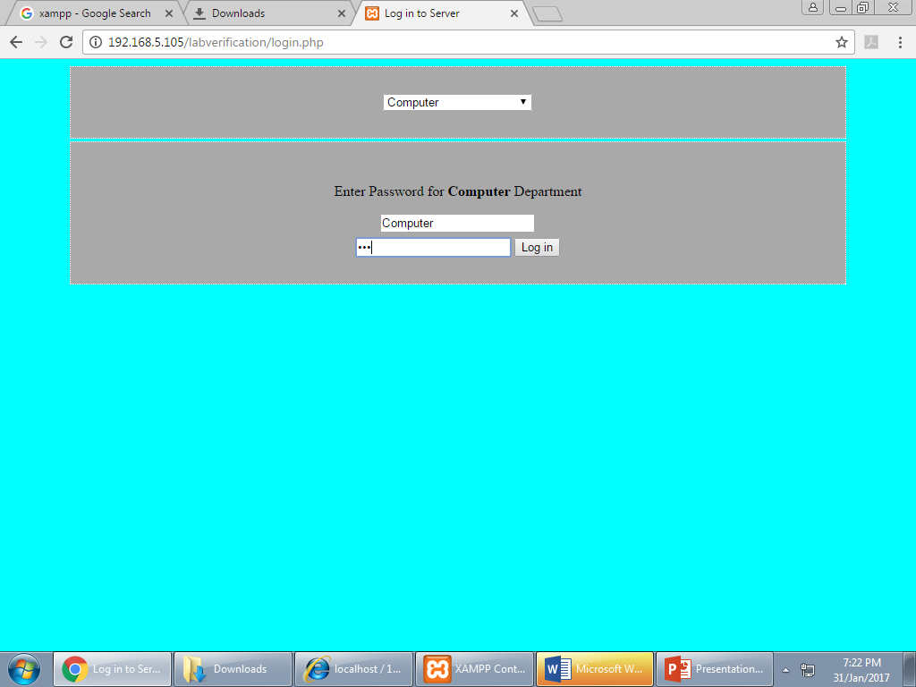
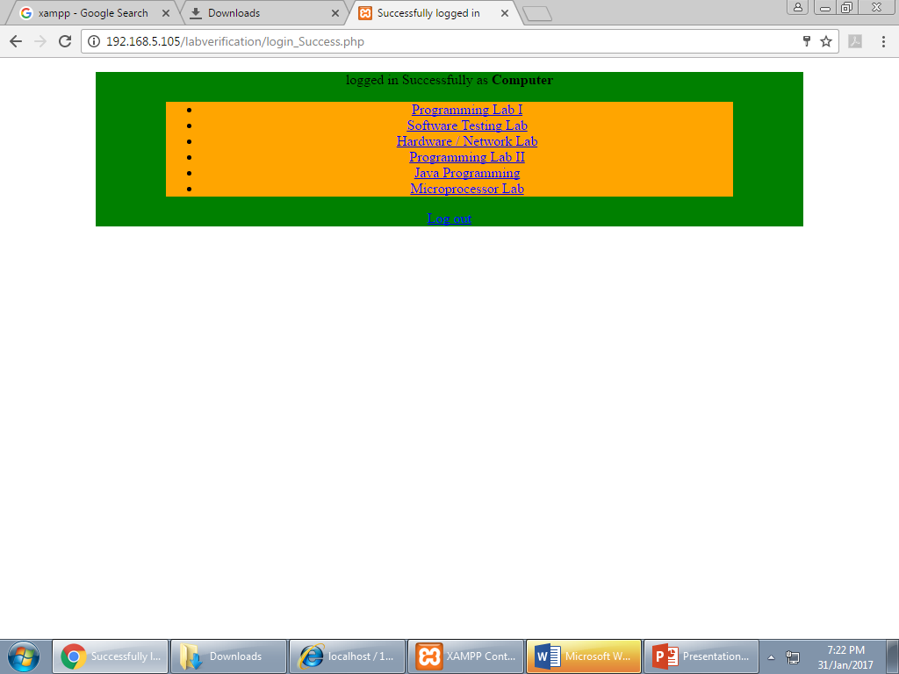
ENTER THE PASSWORD DEPARTMENT WISE
AFTER LOGIN ANY DEPARTMENT
Here is the different password of different department so other will not open this record
When we login any department for example computer you can see different laboratories of computer

Slide 14
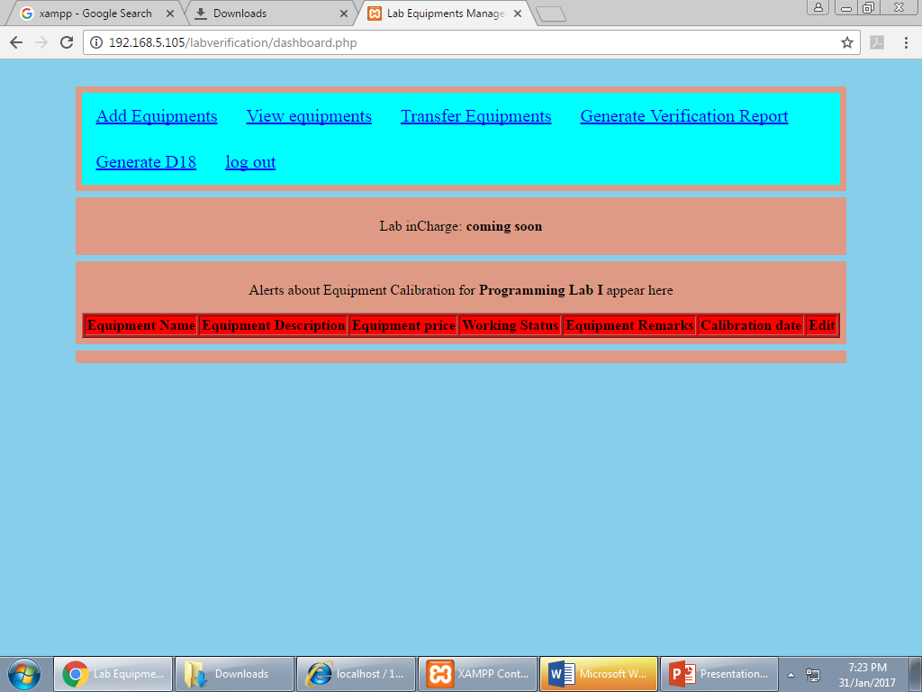
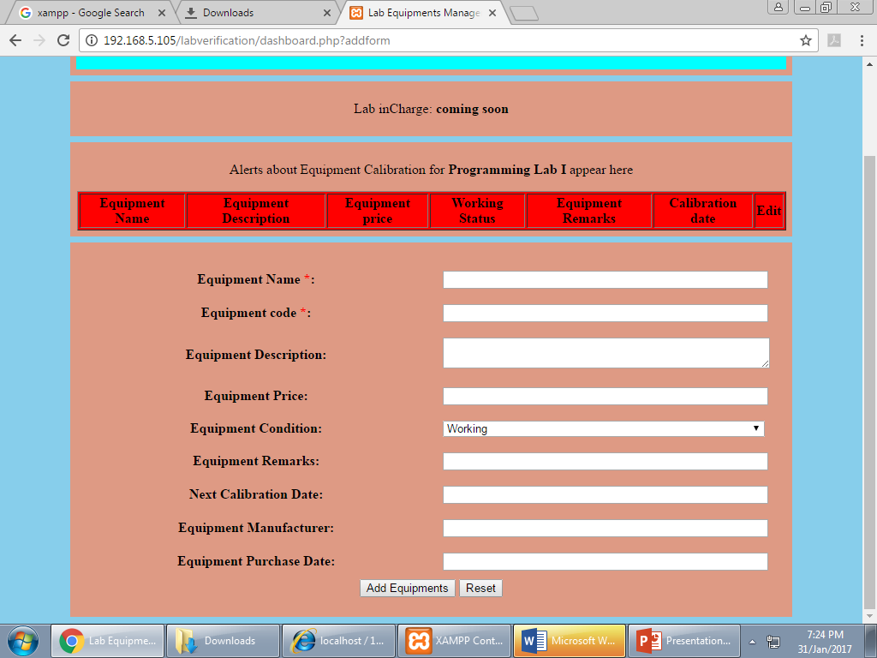
AFTER LOGIN DEPARTMENT
ADD EQUIPMENT
After login department you can add equipment you can view it transfer it and you can generate its report and generate D18 also.
Here you can see description about equipment like equipment name its price its purchase date and its condition and etc.

Slide 15
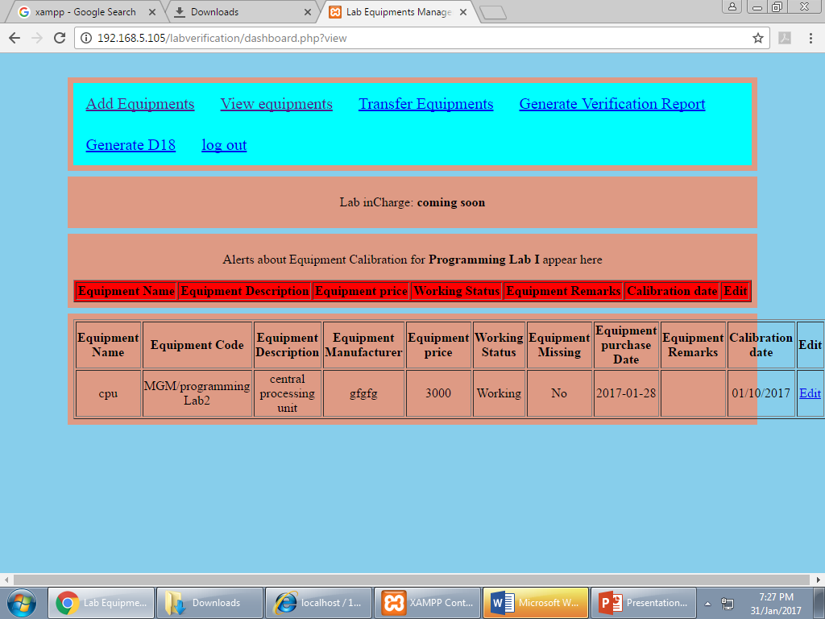
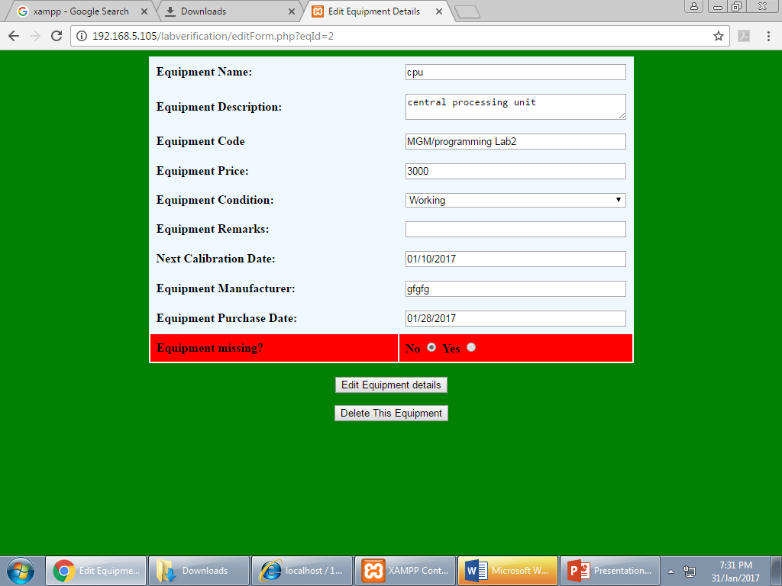
VIEW EQUIPMENT
EDIT EQUIPMENT
Here you can view the equipment which we have added its information like all detail information like previously we have see
Here you can edit equipment if you don’t want to give that information like equipment description is incorrect you can modify it you can delete equipment or whole data of it.

Slide 16
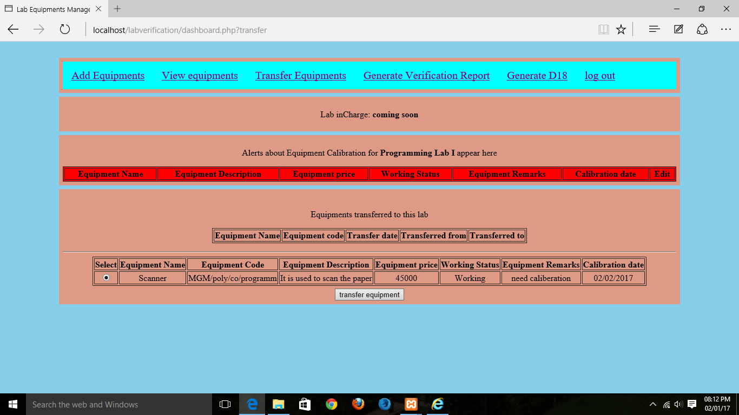
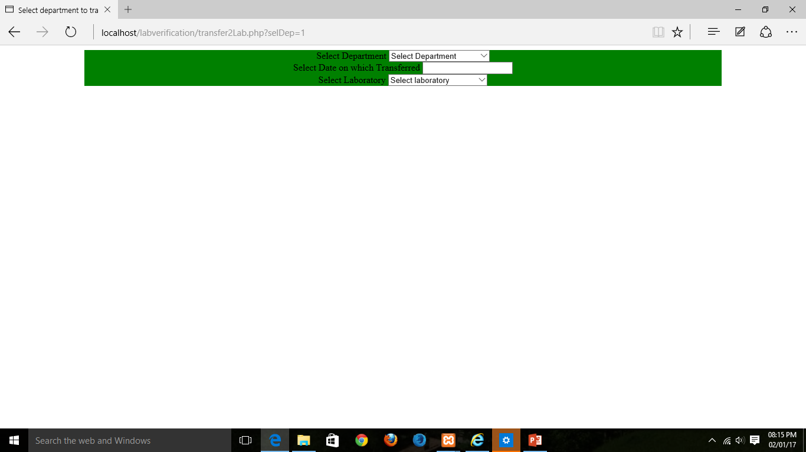
TRANSFER THE EQUIPMENT
Here you have to select which department which laboratory you have to transfer equipment.
Here you have to select that equipment to transfer first select and click on transfer equipment.

Slide 17
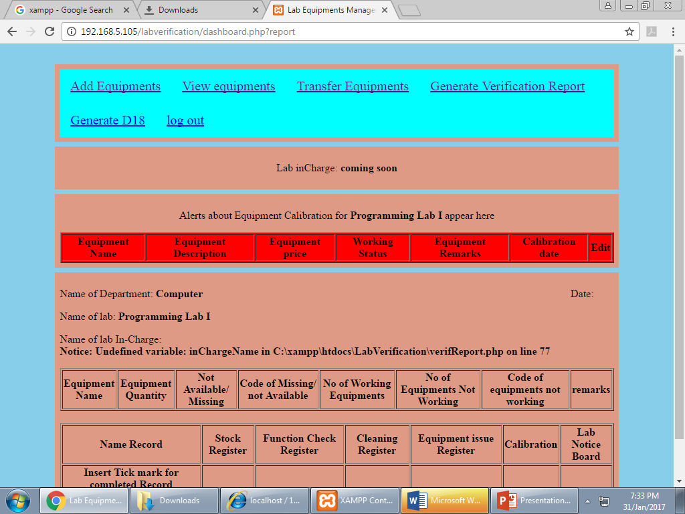
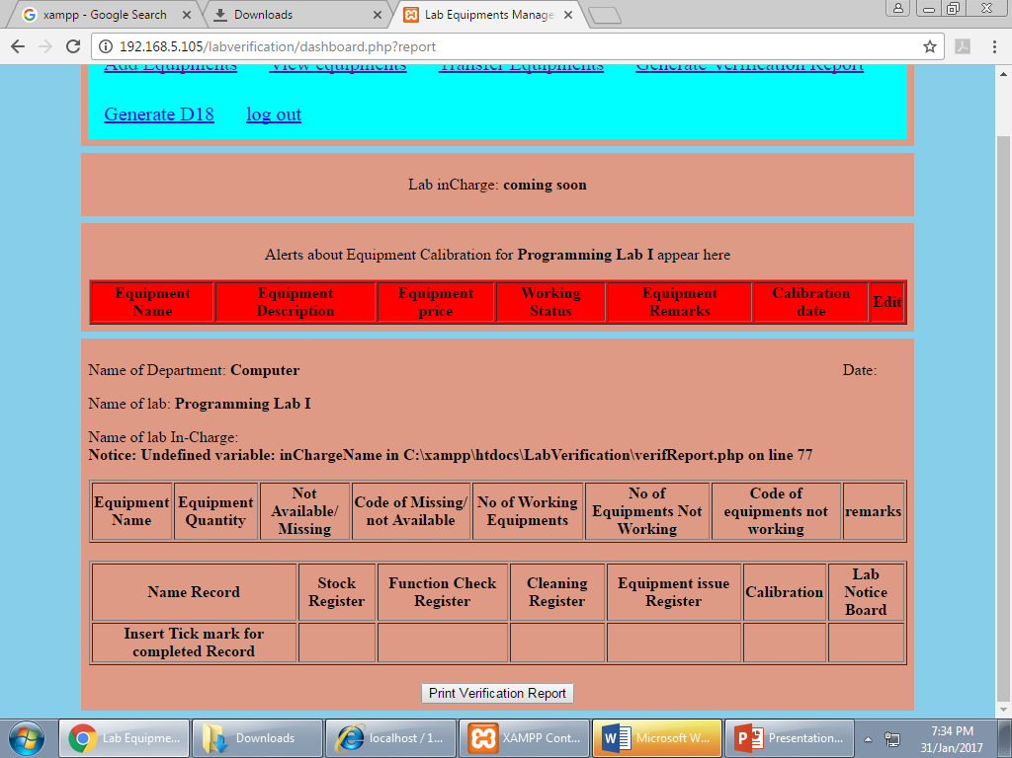
VERIFICATION REPORT
Here you can generate the report after verification of different different labs like it working properly or not.
You can take hard copy also

Slide 18
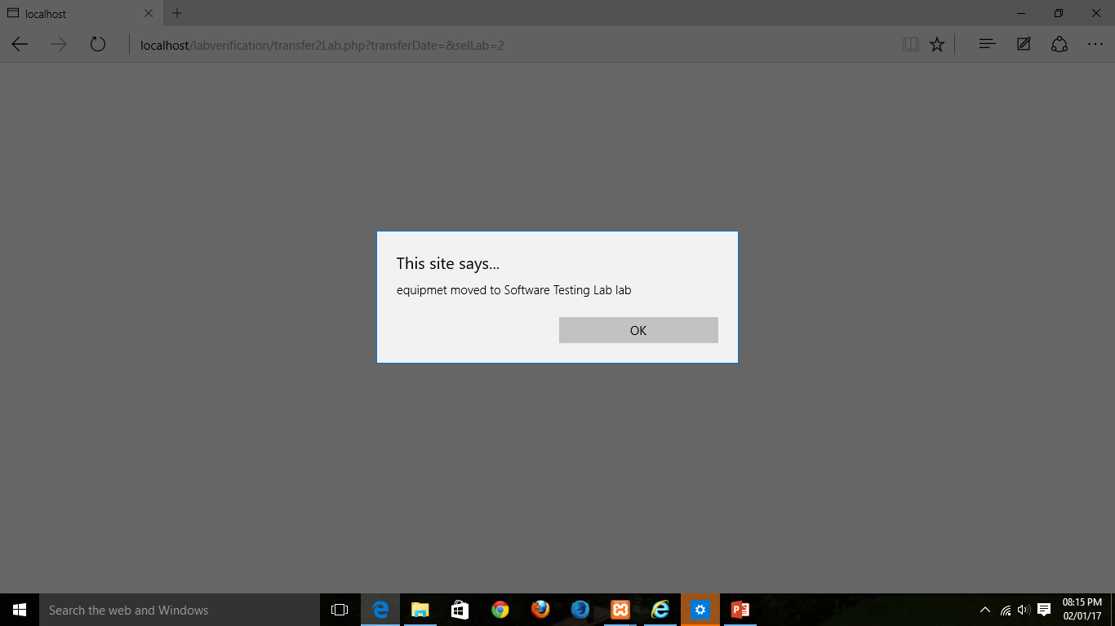
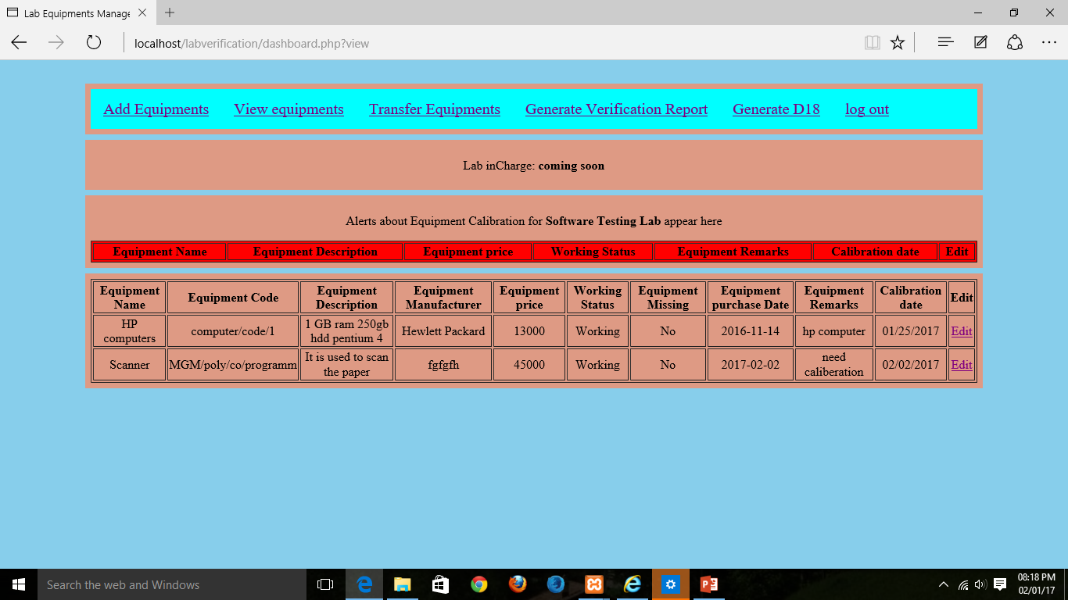
The Equipment is Transferred
Here you have to move to different lab of different department.
Here the equipment is transferred to different lab or we can transferred different departments also.

Slide 19
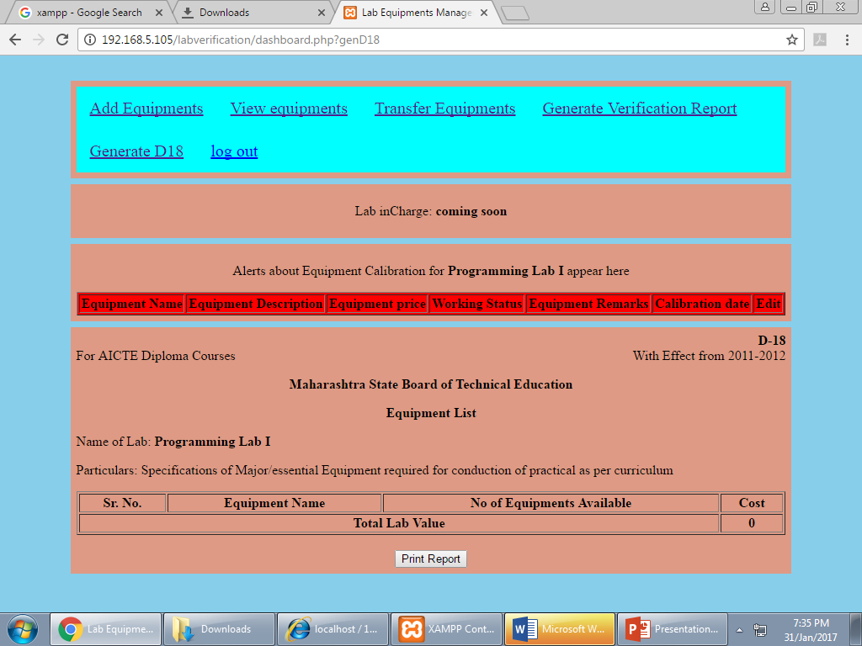
D18
Here it generate final detail of that equipment. i.e. D18.

Slide 20
FUTURE SCOPE
1. It is easy for college to maintain the record.
2. It can be continue in future also.
3. To maintain record you can add more
items or formats also.

Slide 21
Applications of equipment management maybe as follows….
In Hospital: These software will be useful in hospital to manage the equipment of that Hospital like x-ray machine, MRI Machine and Injections etc.
2. In Computer Department: There is a Equipments of computer like cpu monitor, mouse etc.

Slide 22
ADVANTAGES
Its saves time
Avoid paper Work
It will show the reminder for the caliberation of equipment if required.
DISADVANTAGE:
We have to enter record manually.

Slide 23
CONCLUSIONS
Hence this is in the process to complete the application .
We have to enter all the equipments into the application.

